Slide 1


Exzeo software pvt. ltd

Slide 2
Exzeo is a software development company mainly specialized in software product development and software consulting.
‘We're a team of passionate technology lovers building simple and thoughtful software products using Agile and Continuous Delivery process.’
We are part of HCI Group (NYSE: HCI) — a multinational conglomerate based at Tampa, FL, USA Our state of the art development center is located in Noida, India and headquarters is in Tampa.

Slide 3
As a part of HCI
HCI Group owns enterprises engaged in diverse yet
complementary business activities:
Property & Casualty Insurance: Homeowners Choice Property & Casualty Insurance Company is a leading provider of property and casualty insurance in the state of Florida.
Information Technology: Exzeo.com is a cloud-based innovative human capital optimization platform.
Real Estate: Greenleaf Capital manages HCI’s real estate holdings.
Reinsurance: Claddaugh participates in the reinsurance program for the Homeowners Choice insurance division.

Slide 4

Mr. Paresh Patel, Chairman
OUR CHAIRMAN SAYS,
“ My dream is always to bring together a culture that loves what they do and only do what they love. Exzeons are such people. Be it a software development or data analytics or quality assurance, Exzeons are never tired to work on our customer problems.”

Slide 5
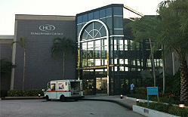

Headquarters
EXZEO USA
5300 W Cypress St.
Suite 100
Tampa, FL 33607
Development Center
EXZEO INDIA
A 42/6, 6th Floor,
Sector 62
Noida 201301
India
Office Locations

Slide 6

Company’s Structure

Slide 7
Technical Heads
Shubhang Bajpai
Project Manager
Himanshu Upadhyaya
Project Manager
Aditya Puri
Product Manager
Vadivel Kumar
CEO
Vaseem Khan
Lead System Administrator
Satish Chandra
Sr Business Analyst

Slide 8
Support Function
Amit Madhav
CA Consultant
Rashmi Chaudhary
Asst. Manager - HR
Kumar Gaurav
Asst. Manager - Admin & Accounts
Sasirekha Vadivel
Head – Operations

Slide 9

Company Policies

Slide 10
Attendance Policy
5 days a week, with Saturday and Sunday being weekly off.
Office timing: 10.00 am to 7.00 pm. (9.00 am to 7.00 pm for Trainees)
Minimum expected working hours in a day - 9 hrs.
Attendance has to be recorded in the Biometric Device.
If any employee forgets to mark his/her presence in biometric, will be considered on Leave.
Either one late arrival or one early departure is exempted in a month.

Slide 11
Leave Policy
S. No. | Leave Type | Acronym of Leave Type | Annual Entitlement (Days) | Minimum Unit in an instance of Leave (Days) | Leave Type Group
1 | Earned Leaves | EL | 13 | 0.5 | Planned Leaves
2 | Carried Forward Leaves | CF | 0 | 0.5 | Planned Leaves
3 | Casual Leaves | CL | 5 | 0.5 | Emergency Leaves
4 | Sick Leaves | SL | 5 | 0.5 | Emergency Leaves
5 | Compensation Offs | CO | 0 | 0.5 | Emergency Leaves
6 | Late Arrival | LA | 3 | 0.25 | Emergency Leaves
7 | Early Departure | ED | 3 | 0.25 | Emergency Leaves
8 | Bereavement | BRV | 2 | 1 | Emergency Leaves
9 | Paternity Leaves | PL | 3 | 1 | Parental Leaves
10 | Maternity Leaves | ML | 84 | 1x84 or 2x42 | Parental Leaves
11 | Leave Without Pay | LWP | 0 | 0.5 | Unpaid Leaves
Leaves can be applied through the following link www.timesheet.com
Note: Trainees are not entitled for any kind of leave during their training period.

Slide 12
Dress Code Policy
For Male Employees:
Formals wear from Monday to Thursday (Shirts and trousers).
Casuals are allowed only for Friday.
For Lady Employees:
Mini-skirts, jogging pants, spaghetti straps, tube and tank tops are not allowed.

Slide 13
Salary Payment Policy
After receiving Appointment letter, employees salary account will be opened by the Admin dept. in Kotak Mahindra Bank.
Salaries transferred date: last working day of the month.
Employee who joins on or after 25th of the month will receive his/her salary of that month along with the salary of the next month.
All the employees are supposed to submit their medical bills to Admin dept. on or before 24th day of the month to get their medical reimbursement.
All the employees will get their salary and leave details in their salary slips, through mail on the next day of the salary transfer.
LWP after 25th will be deducted in next month’s salary.

Slide 14
Performance Appraisal Policy
Exzeo’s Appraisal cycle is on annual basis for all the employees.
Trainees’ first review will be done after 6 months of their joining date as a confirmation of their service to be a permanent employee and their appraisal period will be decided on the basis of their confirmation date rather than joining date.
Appraisal periods:
JOINING DATE | APPRAISAL MONTH
1st January to 30th June of a year | April of the next year
1st July to 31th December of a year | October of the next month

Slide 15
Loan Policy
Eligible to apply for Loan: All permanent employees who have put in a minimum of 1 year service with the Company.
Maximum loan amount: one to two months gross salary only.
For availing the loan facility: an application form has to be filled by the employee and submitted to HR.
Applicant can collect the cheque from Admin department after submitting his/her original Educational Certificates to HR as a security.

Slide 16

Employee Recreation

Slide 17
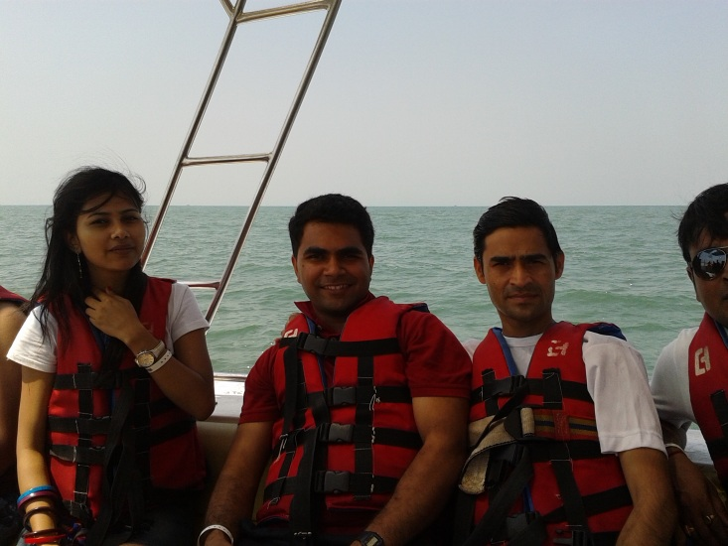
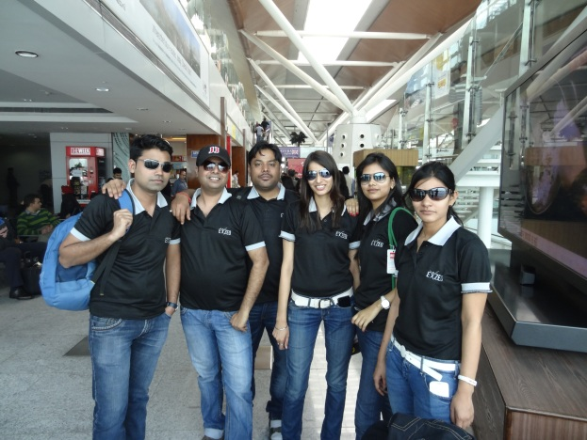
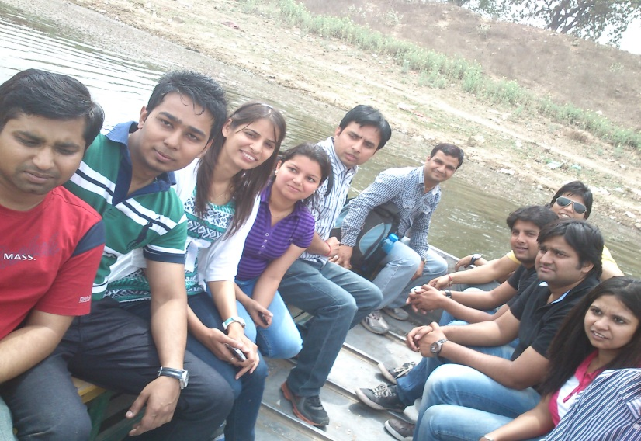
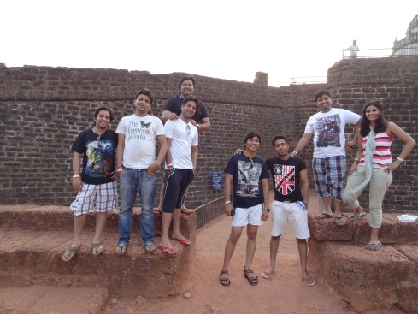
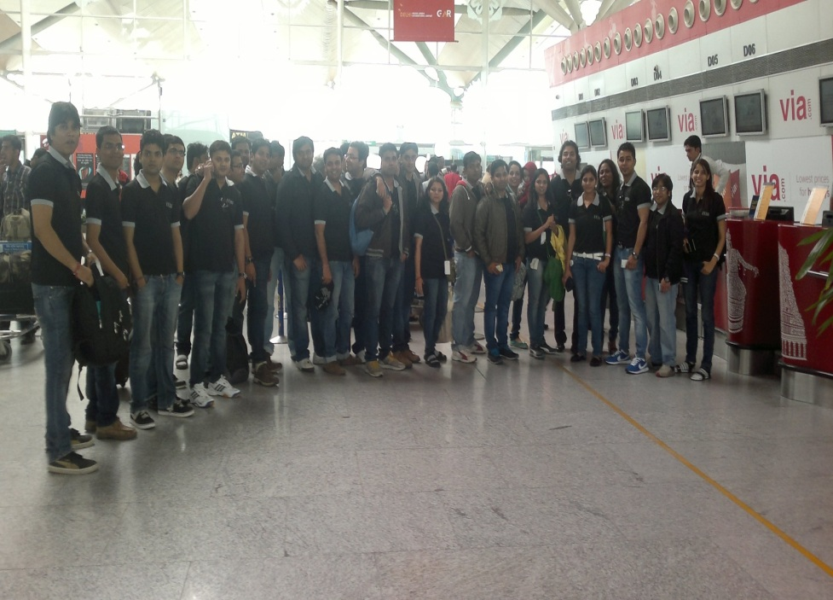
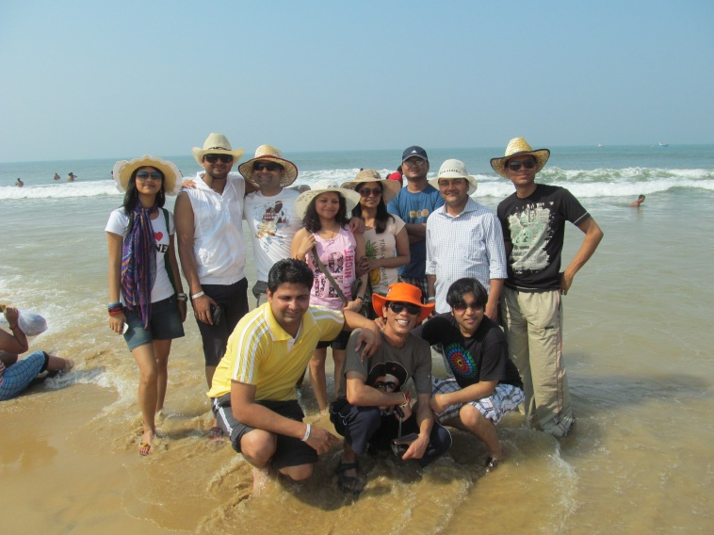
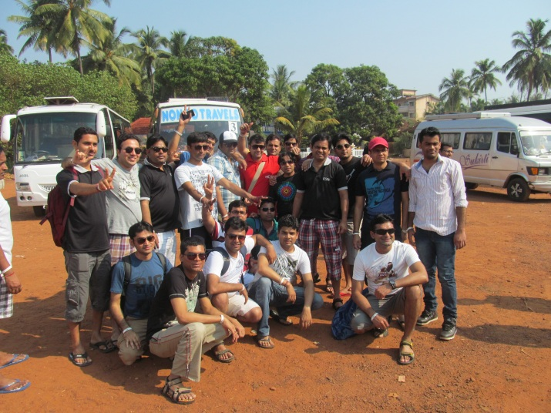
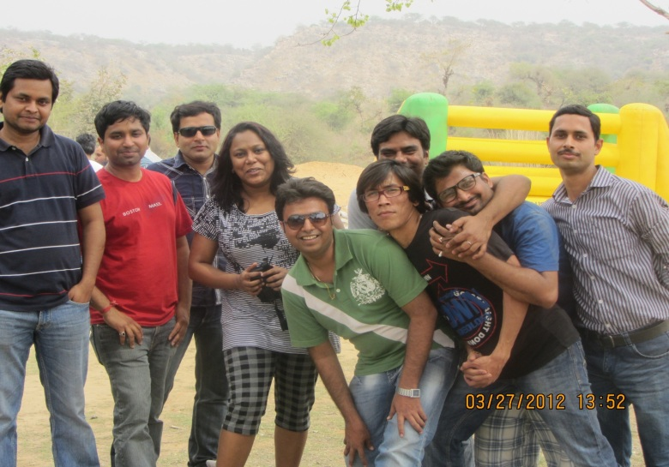
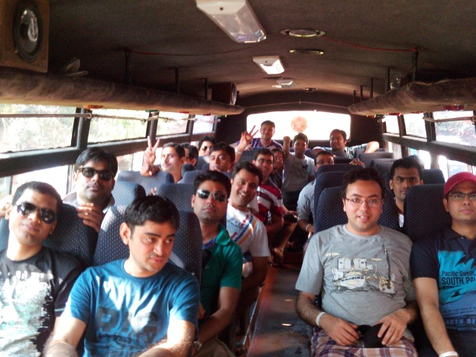

Slide 18
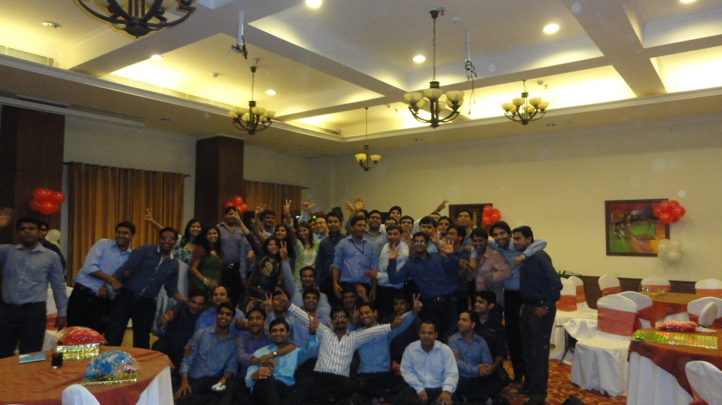
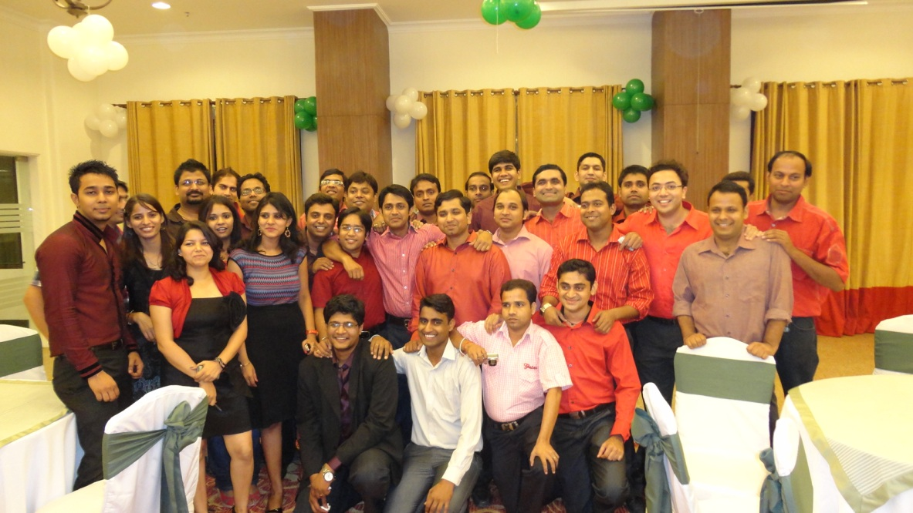
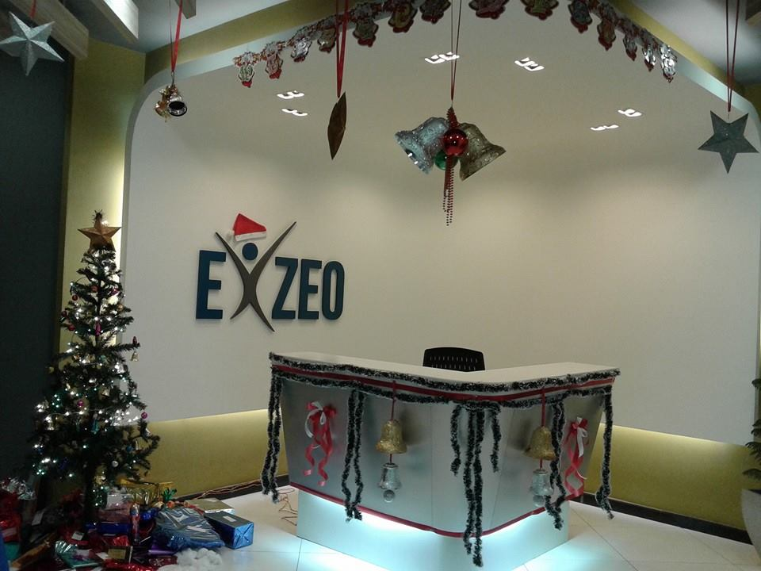
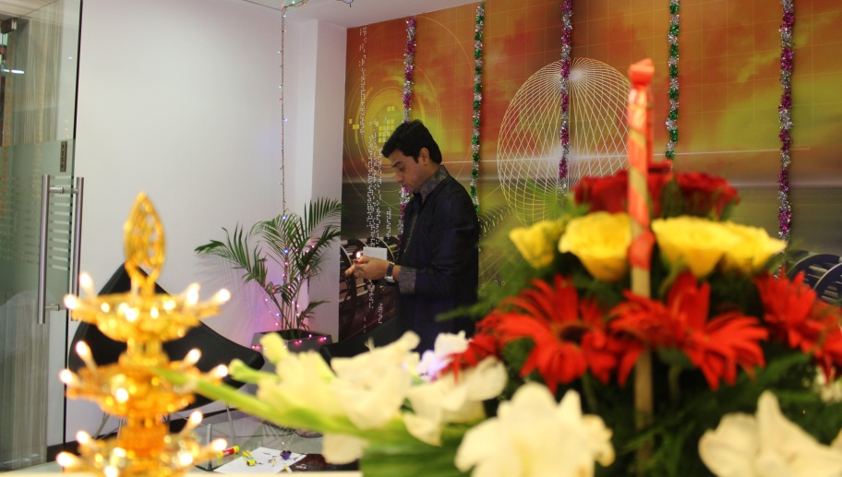
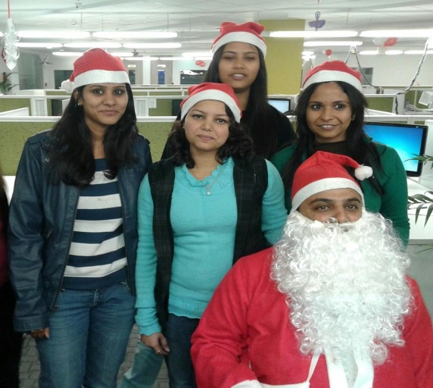
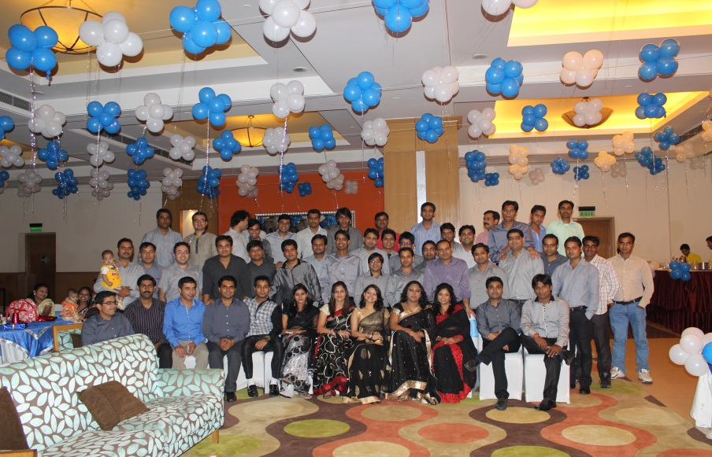
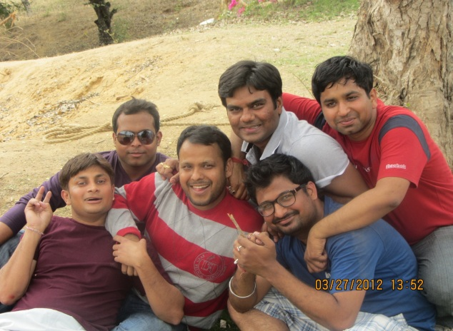


Slide 19

Have a Bright Future at

